Slide 1
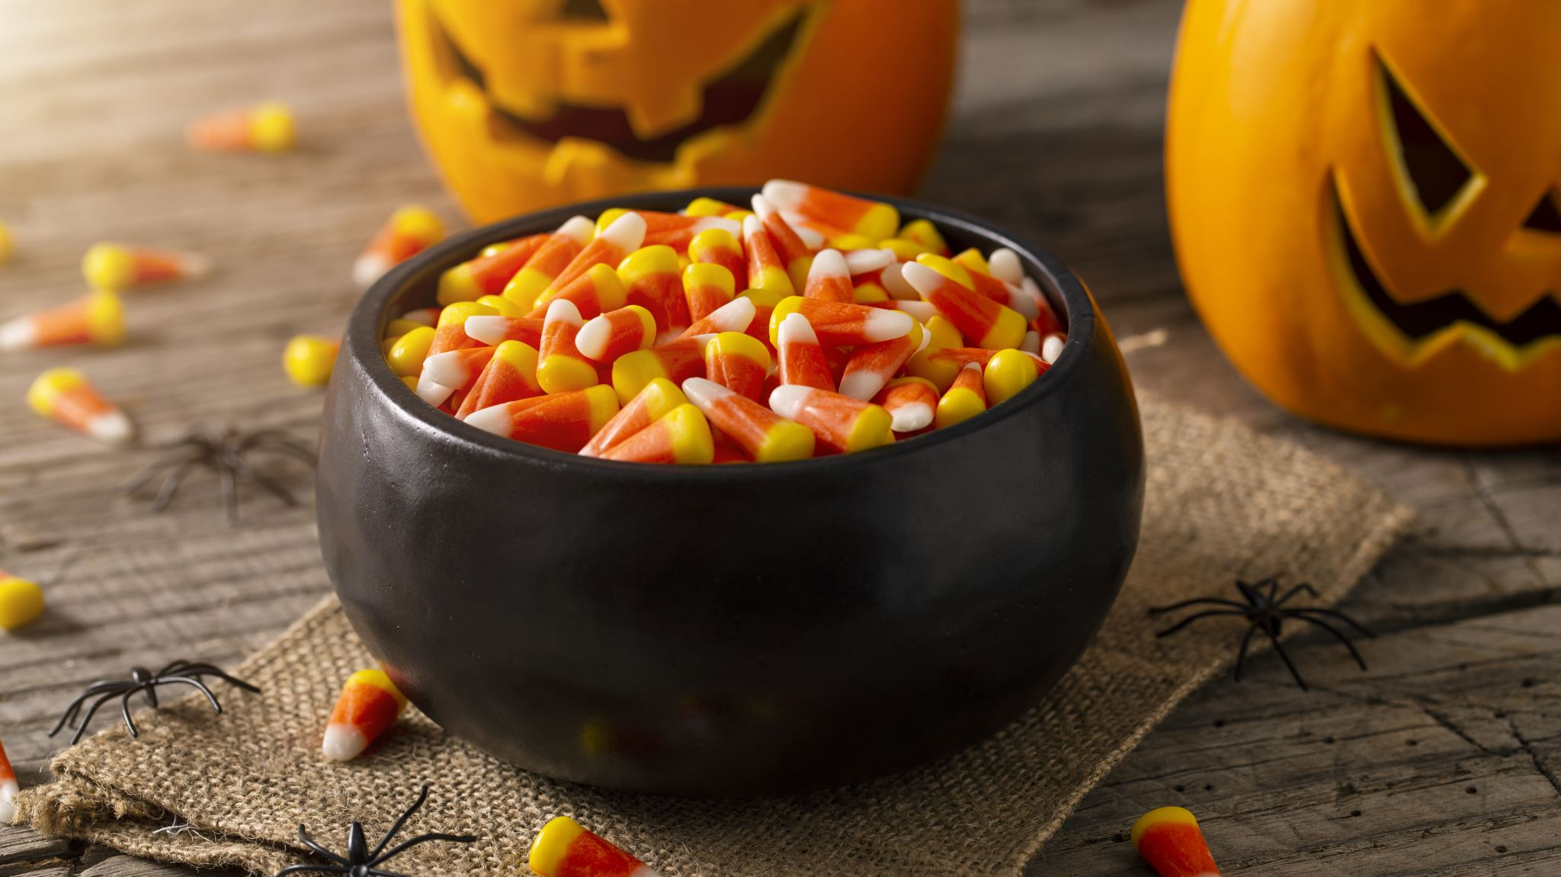
Trick or Script Results
Bruno Sartini (he/him)
b.sartini@lmu.de

Slide 2
Teams
The Pumpkin Spice Coders
Simon Dobmeier Dou Yuchen Yan Ho Leung
Team Mummies
Jessica Kaltofen
Elena Castaldi
Sebastian Reichbauer
Team Dancing Skeletons
Francesca Chessari
Moritz Baiter
Lorenz Absalon

Slide 3
Correctness
The Pumpkin Spice Coders: 4/4 correctly documented functions
Team Mummies: 4/4 correctly documented functions
Team Dancing Skeletons: 3.99/4 correctly documented functions (one very minor mistake)

Slide 4
The winner team is

Slide 5
Team Pumpkin Spice Coders
16:46

Slide 6
Final Results
Team Pumpkin Spice Coders: 16:46 0.6 bonus
Simon Dobmeier
Dou Yuchen
Yan Ho Leung
Team Mummies: 16:48 0.4 bonus
Jessica Kaltofen
Elena Castaldi
Sebastian Reichbauer
Team Dancing Skeletons: 17:34 0.4 bonus
Francesca Chessari
Moritz Baiter
Lorenz Absalon

